Slide 1
Student Orientation
2024/25
Registry

Slide 2
Registry Services
Teams | Services provided
Academic Affairs | Academic Board & various committees Ceremonial functions Scholarships and financial assistance
Admissions | Programme promotion Admissions
Student Administration | Timetabling Course registration Maintenance of student records Examinations Graduation Student Handbook Counter services and enquiry hotline

Slide 3
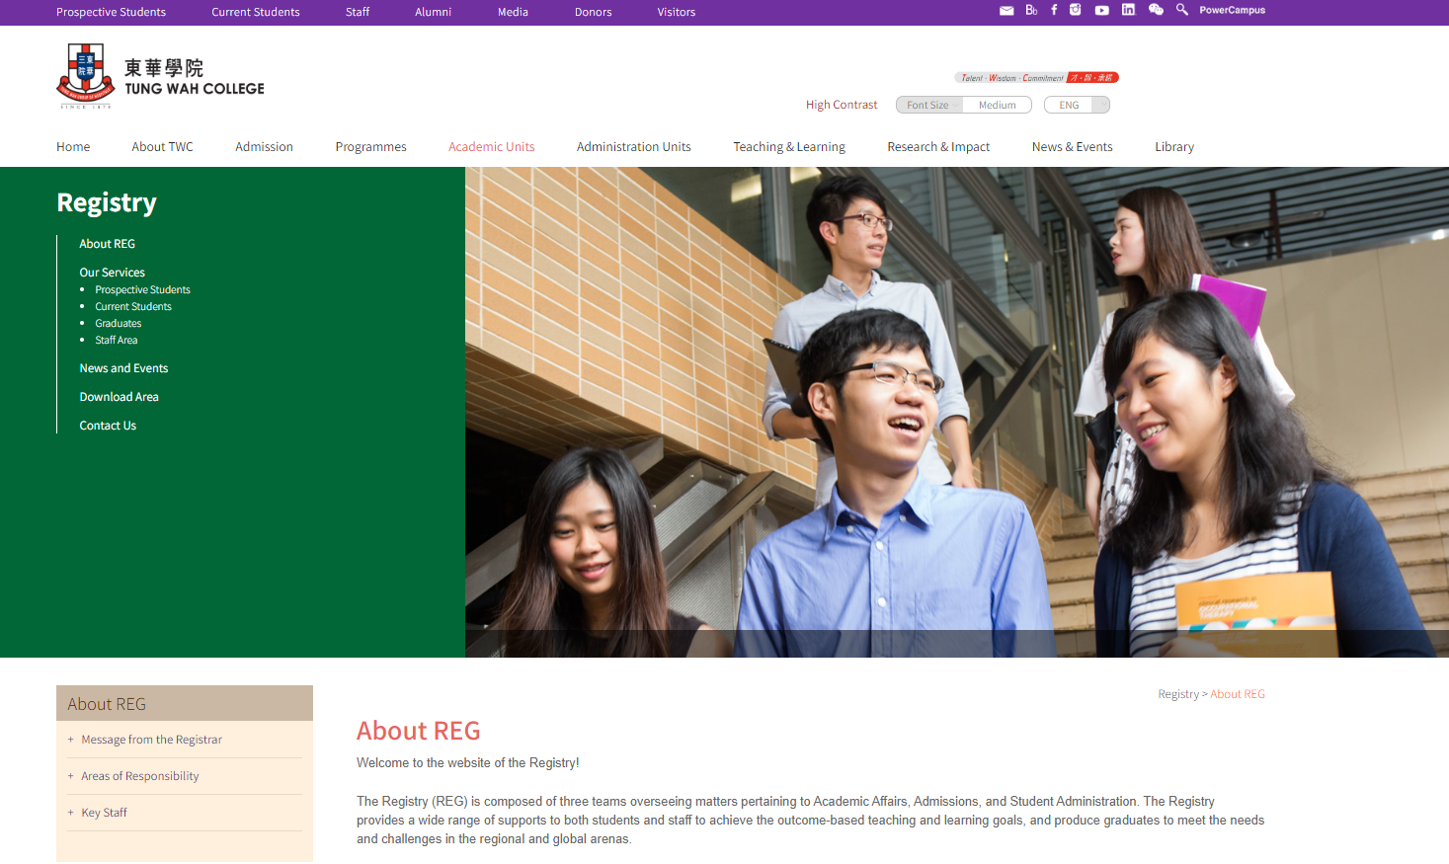
Registry Homepage

Slide 4
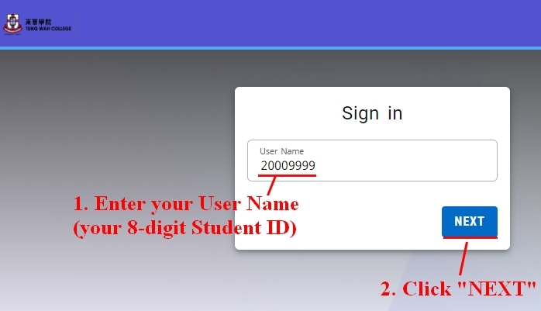
PowerCAMPUS Self-Service
Login PowerCAMPUS

Slide 5
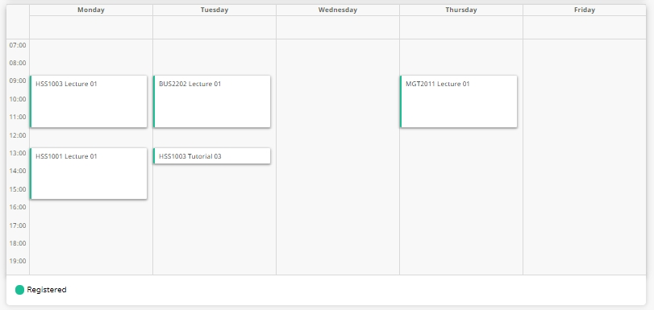
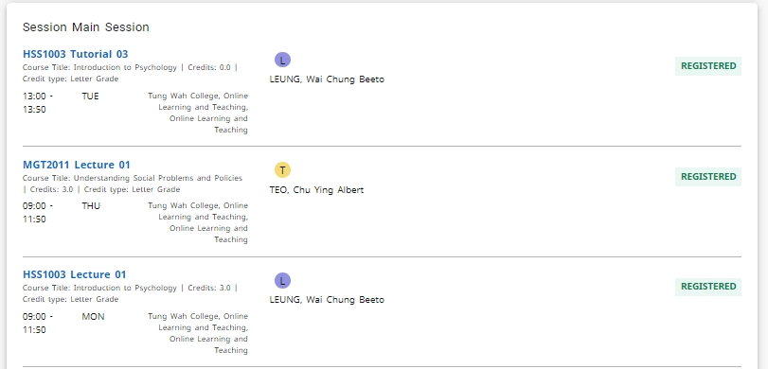
PowerCAMPUS Self-Service
Student Schedule in “Calendar” format
Student Schedule in “List” format

Slide 6
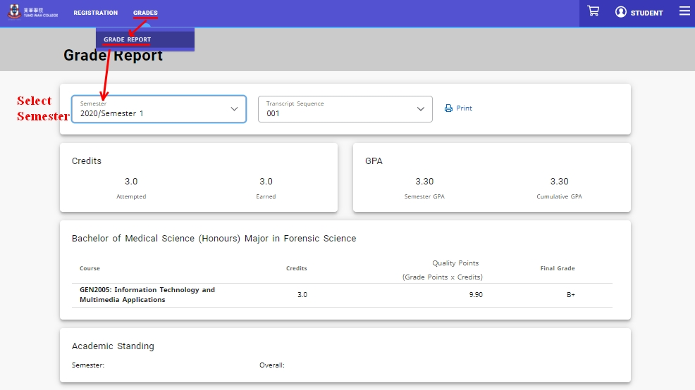
PowerCAMPUS Self-Service
Grade Report

Slide 7
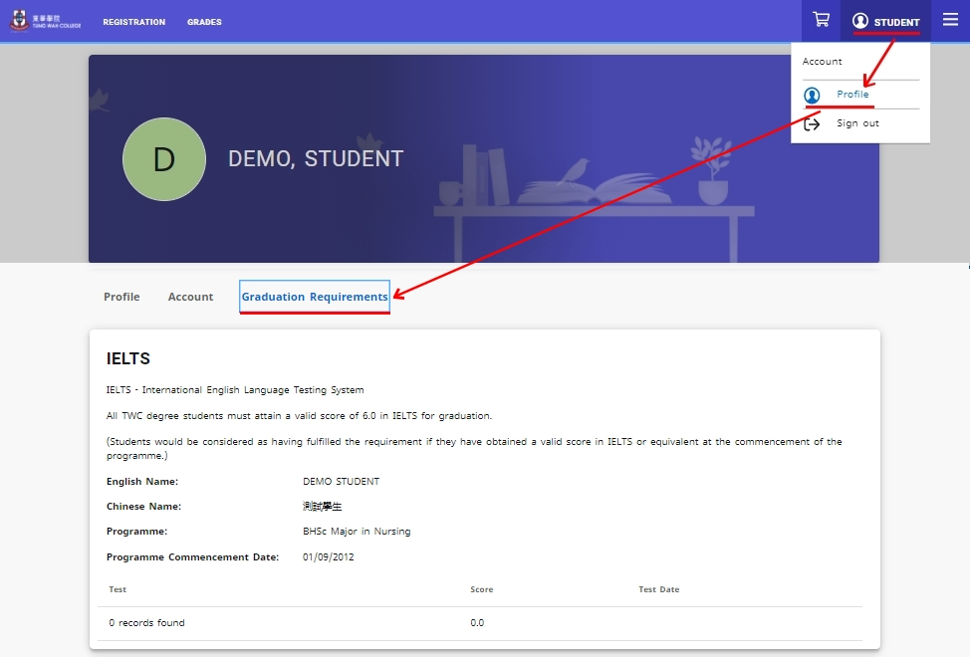
PowerCAMPUS Self-Service
Graduation Requirement

Slide 8
Course Registration

Slide 9
Course Registration & Add/Drop
Bachelor’s Degree (SYE) &
Higher Diploma will be available from
Bachelor’s Degree (FYE)
will be available from
Add/ drop Period
AUG
27
AUG
29
SEP
2-13
Online via PowerCAMPUS
Check pre-registered courses before each semester starts
Perform add/drop if necessary
Late add/drop would not be accepted

Slide 10
Highlights of
Academic Regulations

Slide 11
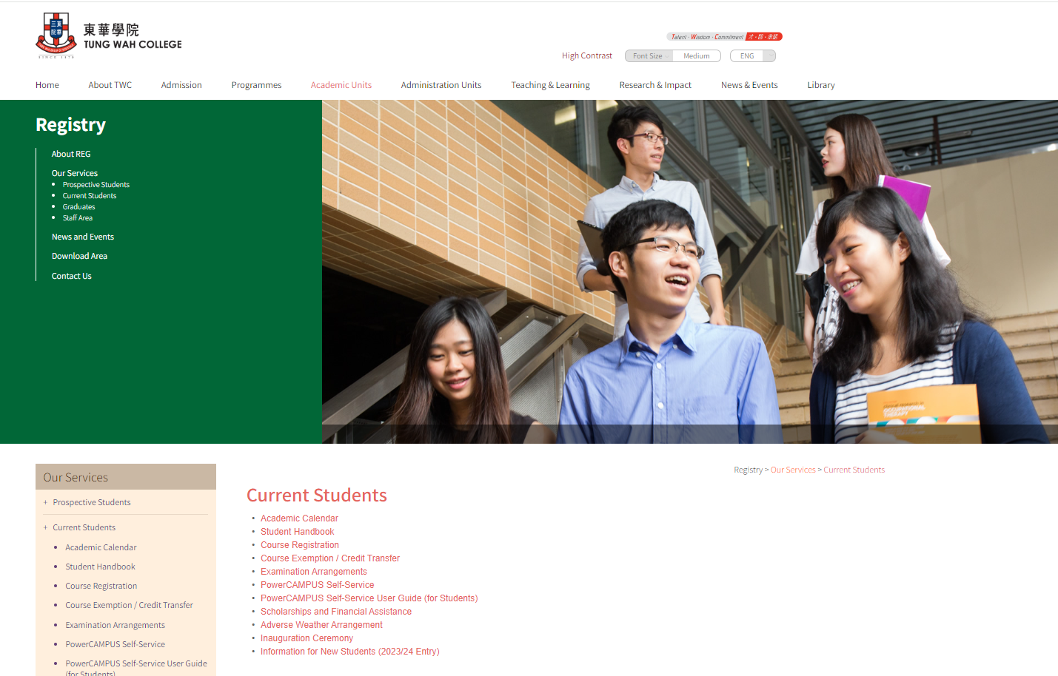
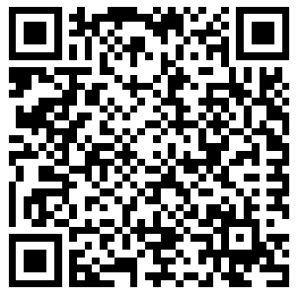
Student Handbook 2024/25
https://www.twc.edu.hk/en/Administration_Units/reg/our_service/current_student/student_handbook

Slide 12
Study Load Per Semester
12
15
21
Minimum
Normal Load
Maximum
credits
credits
credits
Study load varies for different programmes

Slide 13
Duration of Candidature
Programme | Year 1 Entry |  | Senior Entry
 | Normal | Maximum* | Normal | Maximum*
5-year programme | 5 years | 7 years | 3 years | 5 years
4-year programme | 4 years | 6 years | 2 years | 4 years
2-year programme | 2 years | 4 years
*Students must complete the programme requirements within the maximum period of study.

Slide 14
Course Exemption/ Credit Transfer
Previous qualifications with direct relevance
Required Documents
SEP 2-13
Apply no later than the end of the Add/ Drop Period
REG-01
Transcript
(Original & Copy)
Course Outline

Slide 15
Academic Calendar 2024/25
Semester 1 Sep 2 – Dec 7 (14 weeks)
Exam Dec 11 - Dec 21
Semester 2 Jan 13 – Apr 19 (14 weeks)
Exam Apr 23 – May 7
Exam Aug 25 – Jul 29
Semester 3 Jun 2 – Jul 19 (7 weeks)
Exam Aug 25 – Aug 30
Semester 3 for HD(N) year 1 May 19 – Aug 23 (14 weeks)

Slide 16
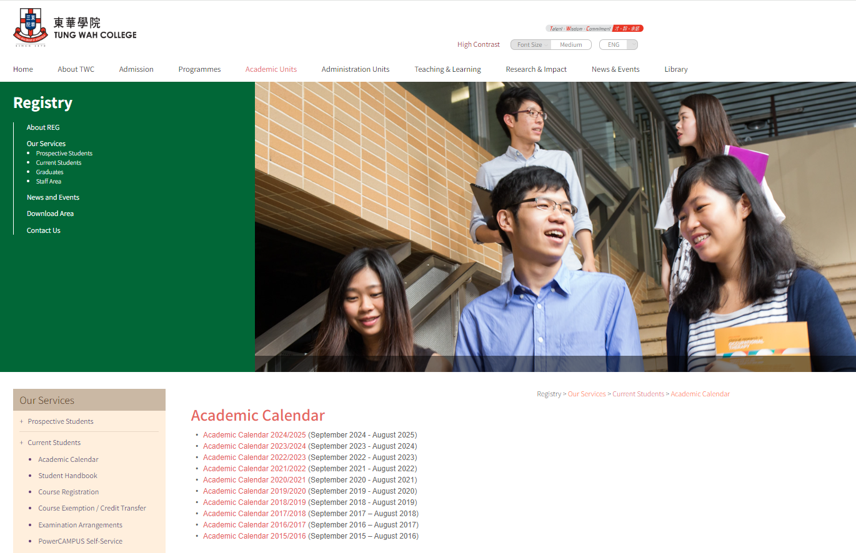
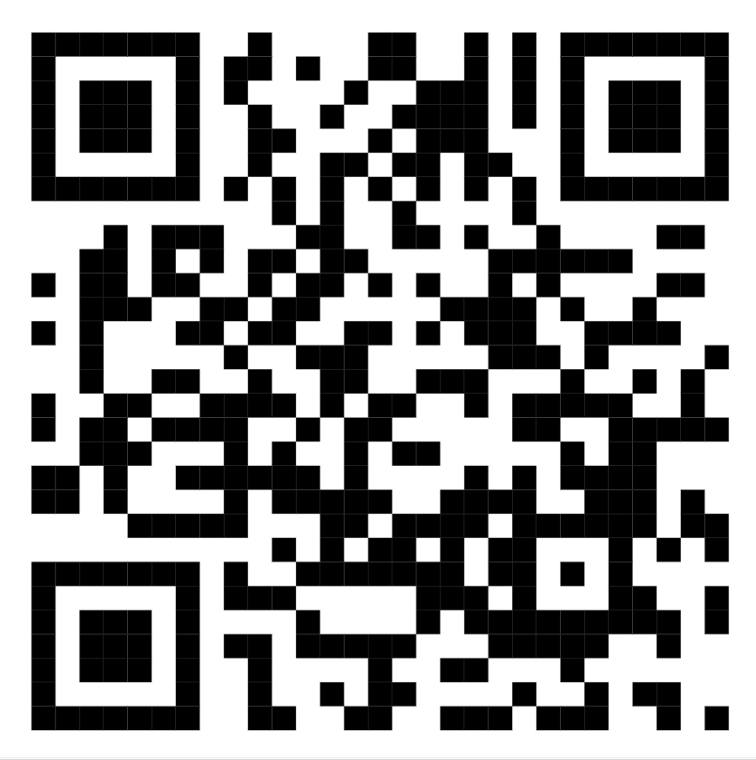
Academic Calendar 2024/25
https://www.twc.edu.hk/en/Administration_Units/reg/our_service/current_student/academic_calendar

Slide 17
Grading Scheme
Grade | Grade Point
A | 4.0
A- | 3.7
B+ | 3.3
B | 3.0
B- | 2.7
C+ | 2.3
C | 2.0
C- | 1.7
D+ | 1.3
D | 1.0
F | 0.0
Passing
grades

Slide 18
Supplementary Exam Rules
&
Absence due to hospital confinement, illness, injury, or other personal emergencies
Submit REG-15 within 7 working days after the date of the concerned examination
Prescribed administration fee ($400/course)

Slide 19
Supplementary Exam Rules
Supporting medical certificates issued by a registered medical practitioner in Western or Chinese Medicine should confirm one of :
Unexpected acute illness
Re-occurrence of a chronic illness
Temporary impairment resulting from an accident
And should be on official letterhead and include the following details:
Date of the medical examination
Nature, severity, and duration of the medical complaints
The medical practitioner’s professional opinion

Slide 20
Academic Probation on Progression
sGPA falls below 2.0 in a semester
Put on Academic Probation in the following semester
Put on extended Academic Probation in the following semester
sGPA falls below 2.0 in two consecutive semesters
If the student obtains a sGPA of 2.0 or above, the Academic Probation will be lifted
* sGPA = Semester GPA

Slide 21
De-registration of Studies on Academic Grounds
sGPA falls below 2.0 for three consecutive semesters;
OR
Fail the second retake of the same course (i.e. fail the third attempt)
De-registration of studies

Slide 22
Graduation Requirements
Minimum required credits
GPA 1.0
gGPA 2.0
FYP/ Practicum
(i.e. Grade D) or above for all courses
Graduation project / practicum (if any)
or above
for the programme
CSP
IELTS 6.0
WILP
GE/ NAVE
Community Service Programme
must be valid within two years of submission date#
Work-integrated Learning Programme*
General Education Requirement including National and Values Education with online quizzes
* For degree programmes only
# Valid score of 6.0 in IELTS Academic or equivalent or completion and passing of ENG4001 English Enrichment Course, students are required to attempt IELTS at least once before they are allowed to enroll in this course

Slide 23
Graduation Requirement under General Education Framework:
National and Value Education (NAVE) and online quizzes
Link to NAVE is found in TWC Blackboard
Complete the NAVE online learning pack (with 5 domains) before graduation
Three-hour learning for each domain
Complete an online learning pack for national and value education and receive a passing grade

Slide 24
Student Conduct
Violation of regulations or misconduct shall be disciplined by the College
Penalties (e.g. written warning, suspension, termination of studies) will be imposed by the Registrar / Student Disciplinary Committee in accordance with the nature and gravity of the offence
Penalties may be kept as a permanent record for serious cases

Slide 25
Financial Assistance and Scholarships

Slide 26
Government Student Financial Assistance by Student Finance Office (SFO) of Working Family and Student Financial Assistance Agency (WFSFAA)
Financial Assistance Scheme for Post-secondary Students (FASP)
Non-means-tested Loan Scheme for Post-secondary Students (NLSPS)
Target Group
Registered students who are aged 30 or below and engaged in full-time locally-accredited self-financing associate degree, higher diploma or Bachelor’s degree programmes
Registered students who are engaged in full-time locally accredited self-financing associate degree, higher diploma or Bachelor’s degree, higher diploma or Bachelor’s degree programmes
Need to go through means test?
Yes
No
Form of Financial Assistance
Grant (no need to repay) and/ or living expenses loan
Tuition fee loan

Slide 27
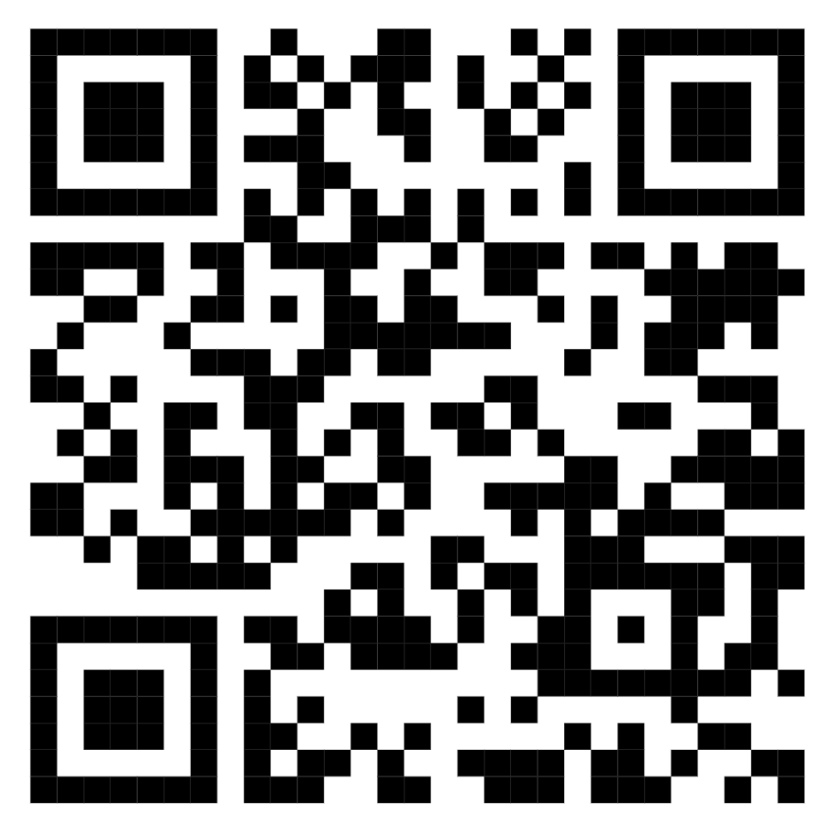
Government Student Financial Assistance by Student Finance Office (SFO) of Working Family and Student Financial Assistance Agency (WFSFAA)
Jan
17
Online application* no later than
*For details, please refer to SFO’s website. For enquiries, please call SFO’s enquiry hotline at 2802 2345

Slide 28
SSSDP and NMTSS forms and procedure
or
Sep 2
Non-means-tested Subsidy Scheme for Self-financing Undergraduate Studies in Hong Kong (NMTSS)
Study Subsidy Scheme for Designated Professions/ Sectors (SSSDP)
Undergraduate Programmes
Sub-degree Programmes
Submit to Registry on or before the start date of the academic year

Slide 29
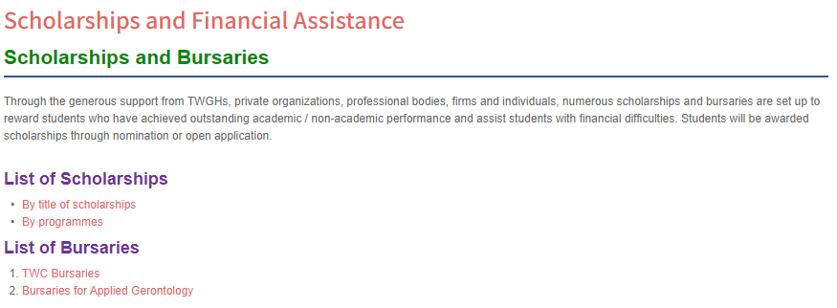
Scholarships and Bursaries
For Selection Criteria, Scholarship Amount, Quota, please refer to the above REG website

Slide 30
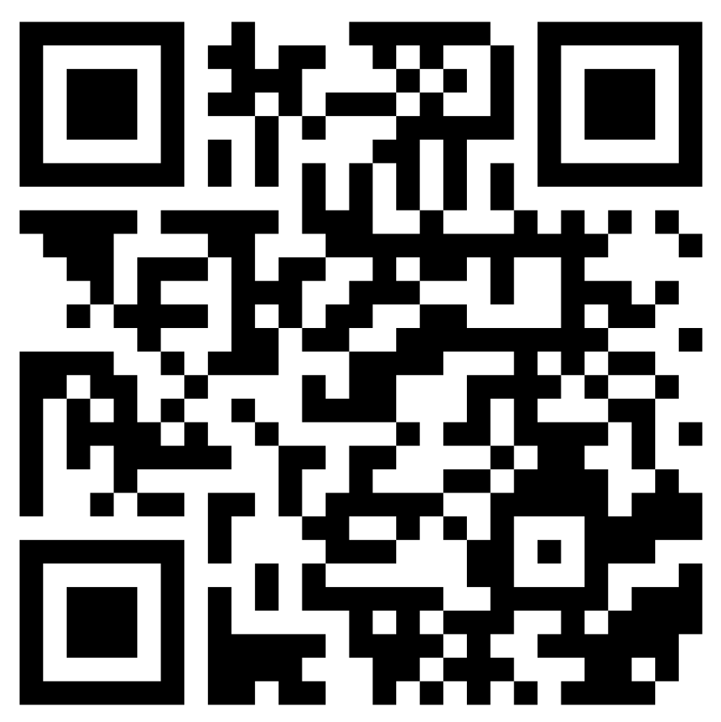
Deferral of Tuition Fee Payment
Government financial assistance
or
Financial difficulties
Select the correct Academic Year and Semester for deferral
Visit TWC deferral payment website
provide all supporting documents
* Supporting documents may include the latest letter in full from the SFO, income proof, etc.

Slide 31
Contact Registry
Service Counter
8/F, KPC
3190 6673
registry@twc.edu.hk
www.twc.edu.hk/reg
Office hours
Mon – Fri : 9:00 a.m. – 5:30 p.m. (open during lunch hours)
Sat, Sun and public holidays : Closed

